Slide 1

Find Your Dublin
Group 1 MSc Team Project

Slide 2
Answering Last week’s Feedback and Questions
1. Make it for everyone, not just international students (team decision)
We can open it to anyone moving to or within Dublin. International students stay as one example user, but the system works on preferences, not on who the user is. Nothing in the scoring depends on being a student.
2. System shouldn't always favour one area
We'll test it with many different preference combinations and check how often each area reaches the top 3. If one area dominates, we'll review the weighting and normalisation. This becomes part of our sensitivity analysis.
3. FastAPI needs to be replaced
FastAPI is widely used in production and suits our Python data work, if it's about using a more established framework, Django or Flask are Python alternatives;
4. Use an enterprise database
PostgreSQL is an enterprise-grade database used by large companies. Neon is just a managed host for it. If needed, the same database can move to an enterprise host such as Azure or AWS without code changes.

Slide 3
Requirement Specification
Req ID | Name of Req | Description | Priority | Who uses it? | Release/Week
1 | Reccommending Area | Recommend top 3 dublin areas based on user preference | A | User
2 | Explaining the reccommendation | Explain the shorlist | A | User
3 | Calculate distance of commute | Calculates distance from university to reccommending area | A | User
4 | Find supermarkets in a particular area | Investigate and confirm number of supermarkets in each area | A | User
5 | Find parks | Investigate and confirm number of parks in each area | A | User
6 | Find gyms | Investigate and confirm number of gyms in each area | A | User

Slide 4
Req ID | Name of Req | Description | Priority | Who uses it? | Release/Week
7 | Find cafes/restaurants | Investigate and confirm different types of cafes/restaurants in each area | A | User
8 | Find pharmacies and hospitals | Investigate and confirm number of pharmacies and hospitals in each area | A | User
9 | Find shopping malls | Investigate and confirm number of shopping malls in each area | A | User
10 | Area demographics | Display useful Census demographic information about each area | B | User
11 | International community | Show demographic community information from Census data | B | User
12 | Student feedback | Allow students to rate/ share info about their area | B | User
13 | Mobile responsive UI | Website properly works on phone,tablets,desktop | A | User

Slide 5
Where students live in Dublin
Commutes, transport, facilities and safety
Insights from 57 valid student survey responses By: Shreyas Chandradip Salunke

Slide 6
The survey at a glance
Where you live shapes the whole student experience
57
50 min
8.0 / 10
7.7 / 10
valid student responses
typical commute to university
average safety score
average overall experience
Being close to campus is the number one benefit of an area.
Long commutes are the biggest issue, not safety.
The Luas Green Line is the most useful route to Grangegorman.

Slide 7
Students are spread out
Where respondents live (top 10 areas, n = 57)
38 of 57
live in D01–D24 postcodes
19
live further out, 9 in Co. Dublin towns, 10 outside the county
25 areas
no single "student area", so a recommendation tool makes sense
Blue: Dublin postcodes Amber: Co. Dublin towns Grey: outside Co. Dublin

Slide 8
Commutes are long
Commute time to university (n = 56, median 50 min)
57%
travel 45 minutes or more each way
41 / 72 / 92 min
Dublin city / Co. Dublin towns / outside
8.8 vs 6.8
area rating for ≤15 min vs 90+ min commutes
Minutes each way

Slide 9
Bus and Luas lead
Transport modes used (students could pick more than one)
24 of 30
Luas users take the Green Line
42%
use two or more modes, so smooth connections matter
2 students
drive to university

Slide 10
Everyday needs are covered
Facilities near where students live
86–88%
have a cafe or pharmacy nearby
30%
have a hospital nearby
Lidl 79%
Tesco 68%

Slide 11
Safety is good, overall is lower
Ratings out of 10 (n = 57)
89%
give safety a 7 or above
8.3 vs 6.7
students who feel very safe vs less safe
Concerns are (drugs, antisocial behaviour, dark areas at night) they are not general fear.

Slide 12
Feeling safe is not feeling settled
Average scores by where students live
Outside Co. Dublin
Co. Dublin towns (e.g. Lucan, Balbriggan)
8.9
7.7
7.2
8.1
safety
overall
safety
overall
Safest, but long travel times drags the overall experience down
Lowest safety scores, yet the highest overall experience

Slide 13
What students should look for
Shorter commutes, they drive the highest area ratings.
Areas near the Luas Green Line.
Easy connections if you use more than one mode.
Local safety detail, not just a general score.

Slide 14
What I Researched? – By: Santhosh Sekar Asha
- Analyzed Housing Made Easy project – what is useful?
- That project was developed for Baltimore, Maryland
- One notable feature which could be useful for us.
Crime record score

Slide 15
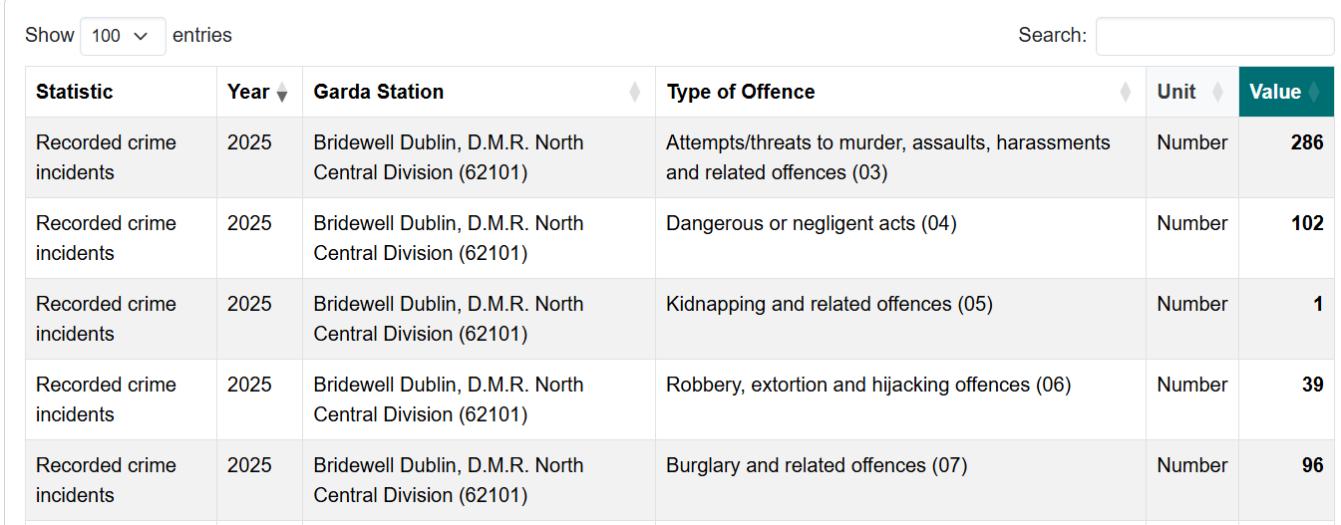
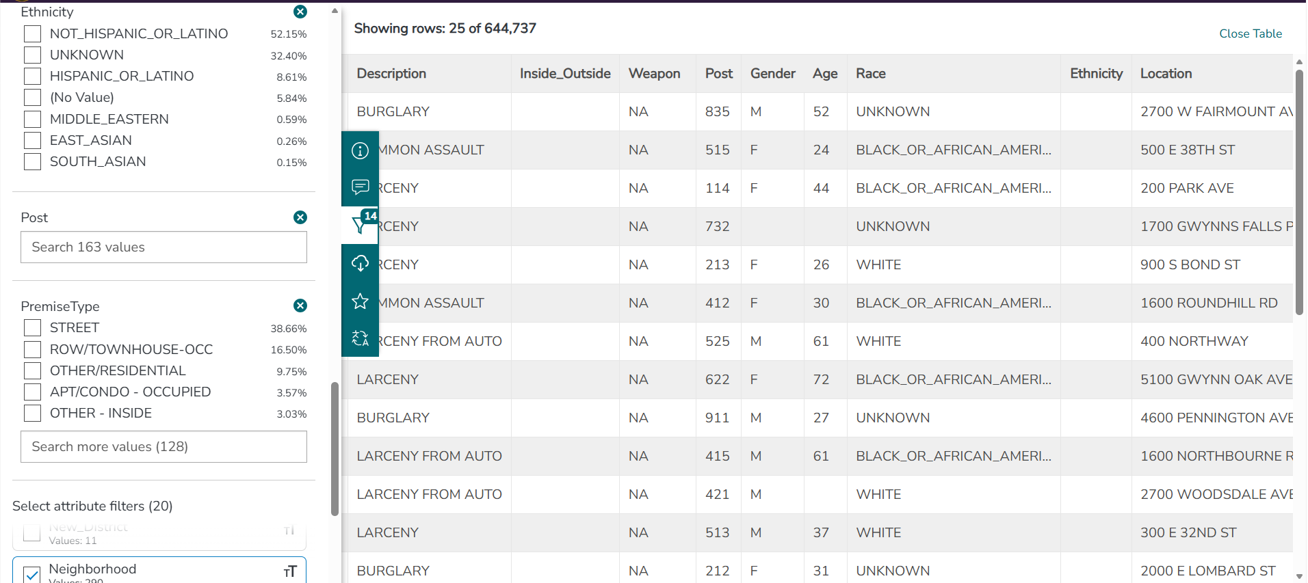
Dublin Crime dataset
Vs
Baltimore Crime Datasets

Slide 16


Analysis of Tech Stack
Open Street API
Google maps API
Used to find nearby amenities for each property
Could not store business names – only location saved
Max 60 results per search, one category at a time
Needs billing account – paid at high usage
Free and open – no card, no billing risk
Can store names – e.g. "Nearby: Lidl, Tesco"
One query gets all amenities in Dublin – no limit
Cuisine tags help our international food feature

Slide 17
Data Collection – By: Vikneshwaran Venkatesh
My task this week was to collect data to build the prototype
I collected 4 main data
  Rent
  Commute
  Amenities
  CSO Census

Slide 18
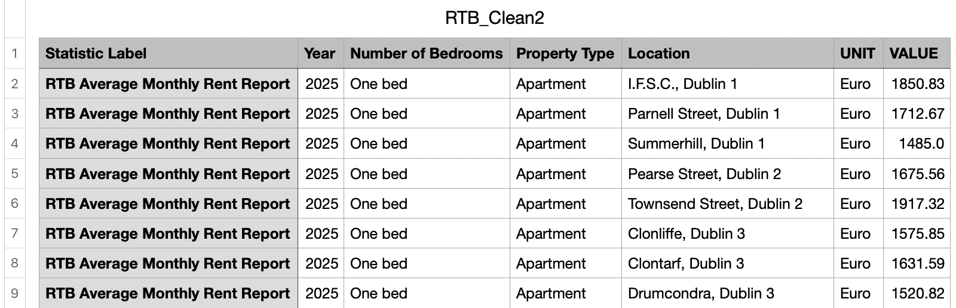
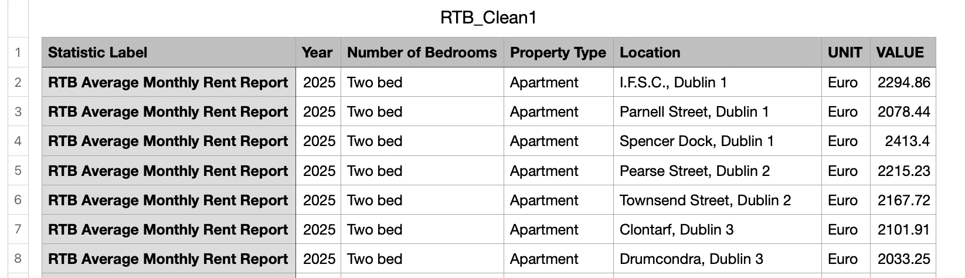
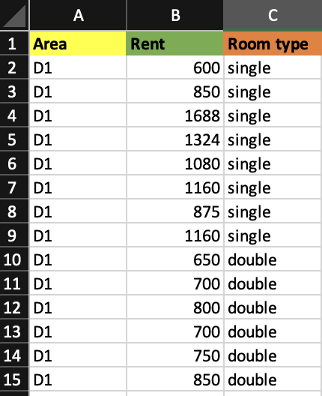
RENT
I used RTB dataset to collect 1 bhk, 2 bhk, 3 bhk apartment type rents from D1 to D24.
Then I used daft.ie and rent.ie to collect single sharing and double sharing room rents from D1 to D3.

Slide 19
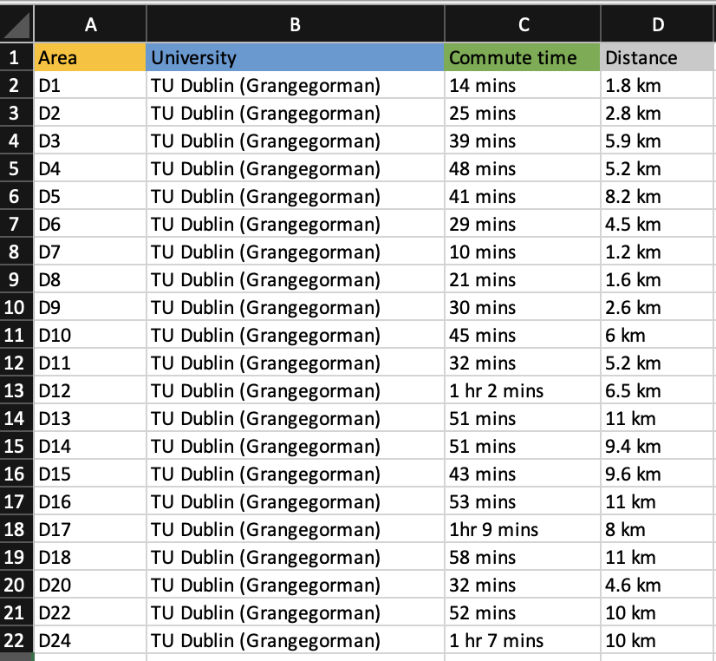
COMMUTE
I used Google Maps to investigate travel times from D1 to D24.
Recorded travel time and distance by public transport between Dublin areas and university campuses. (Only TUD grangegorman campus data is taken for the implementation)
Commute time will be used as a recommendation factor

Slide 20
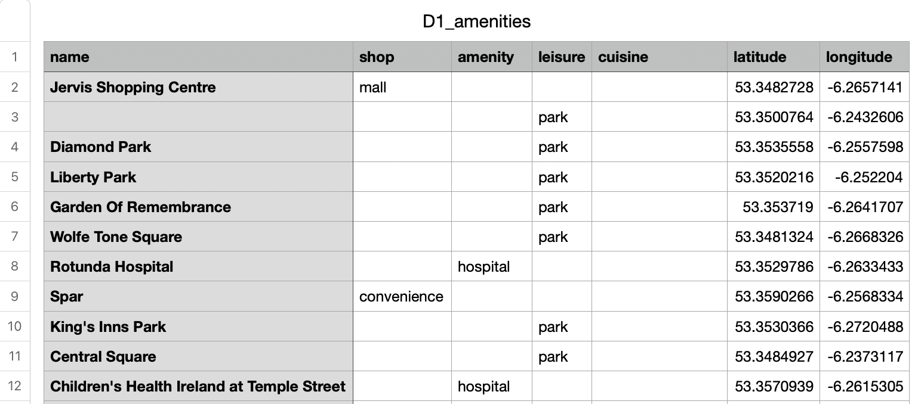
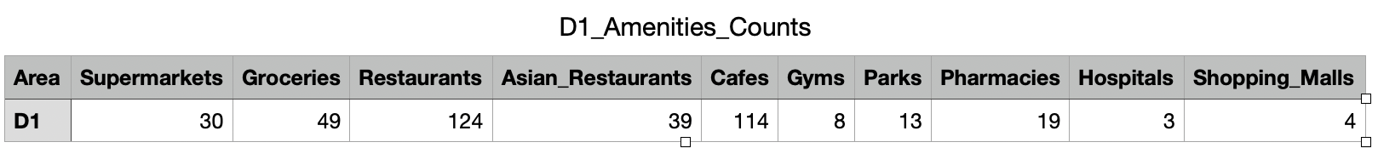
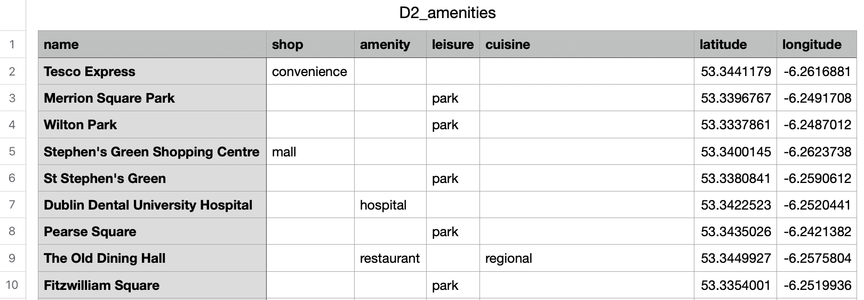
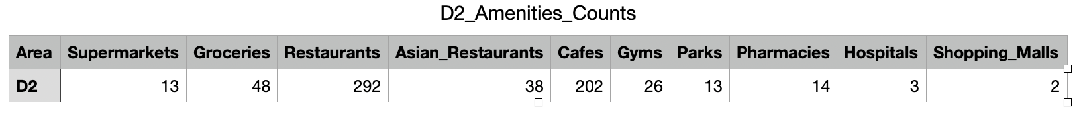
AMENITIES
I used OpenStreetMap + Overpass API to scrap amenities in D1 to D3 like:
  Supermarkets & groceries
  Cafes
  Restaurants
  Asian restaurants
  Gyms
  Parks
  Pharmacies
  Hospitals
  Shopping malls

Slide 21
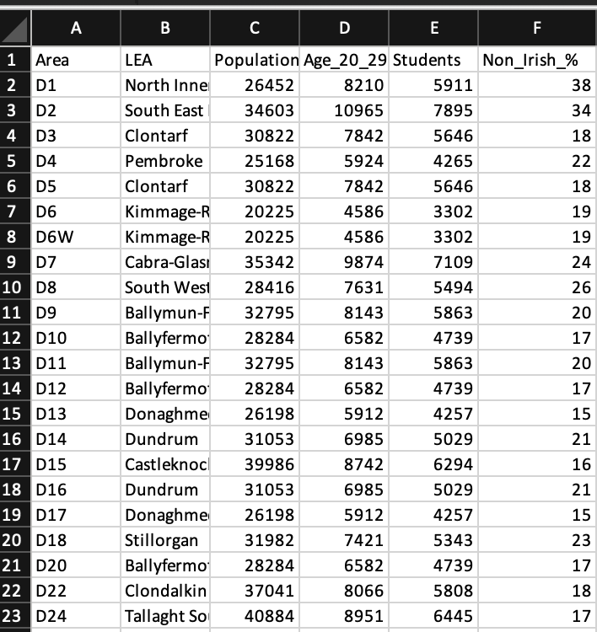
CSO CENSUS
Collected:
  Population
  Age 20–29
  Student population
  Ethnicity/community profile

Slide 22
FOR NEXT WEEK……
Complete Rent Data
  Collect rent data for the remaining Dublin areas
  Continue collecting single, double and shared-room rents
  Collect student accommodation rents
Complete Area Amenities
  Collect OSM amenity data for D4 TO D24
Complete Commute Data
  Include major Dublin universities

Slide 23
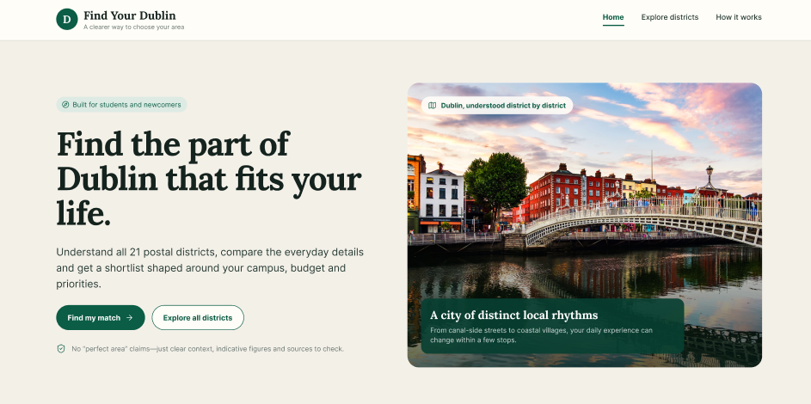
Frontend Prototype using Figma
By: Sowmiya Madhan Kumar

Slide 24
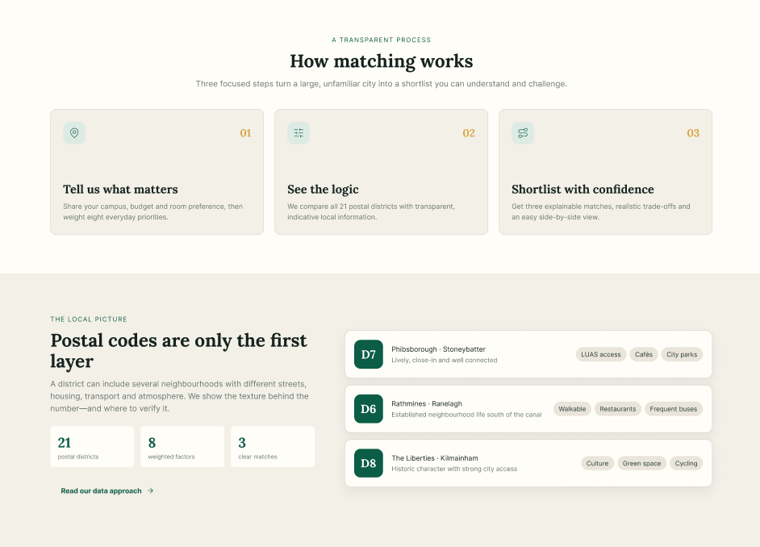
Simple Explanation for Users:
Matching concept
Explainable steps: needs → factors → shortlist.

Slide 25
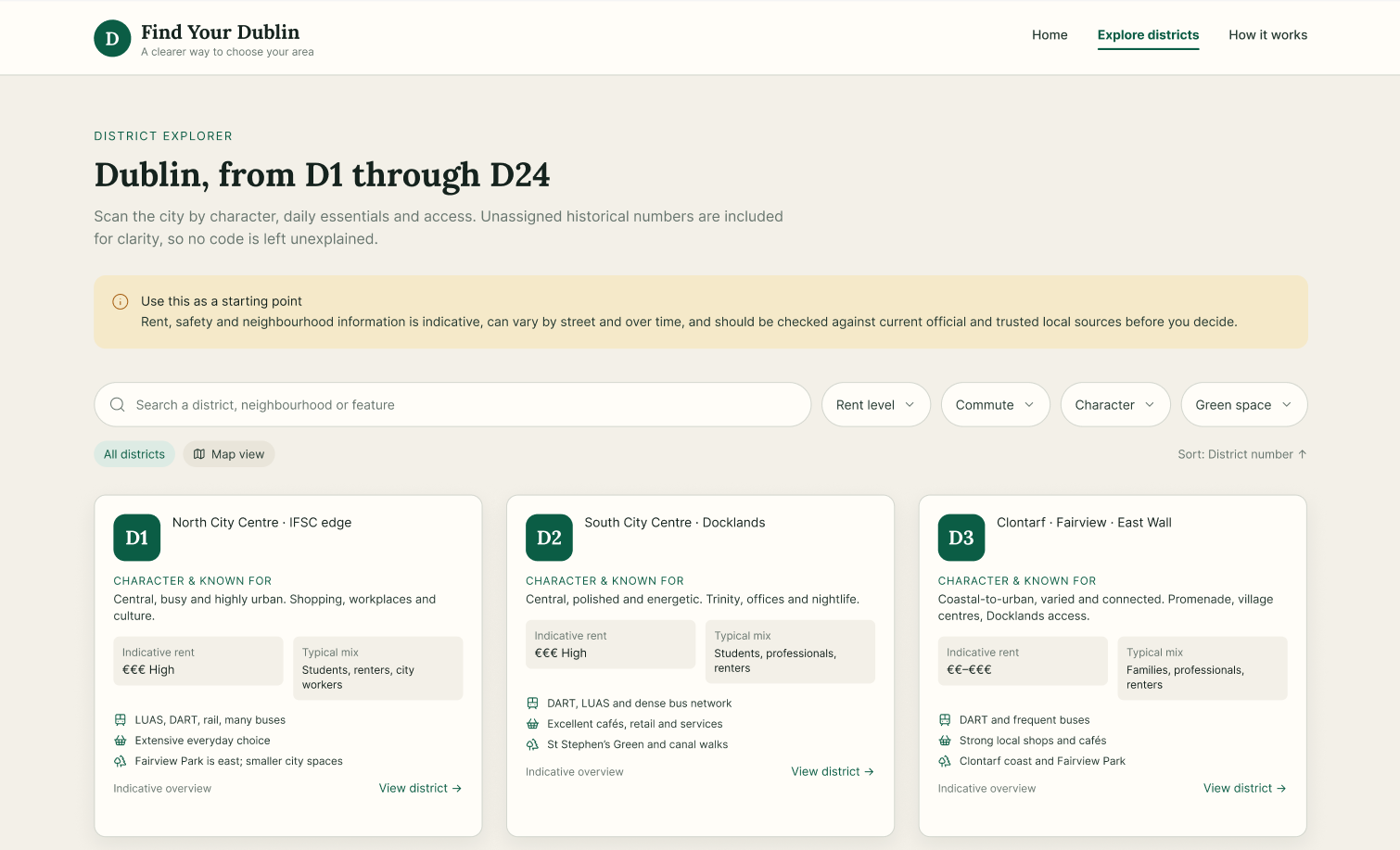
District exploration
Search and filters make the 21 districts easier to navigate

Slide 26
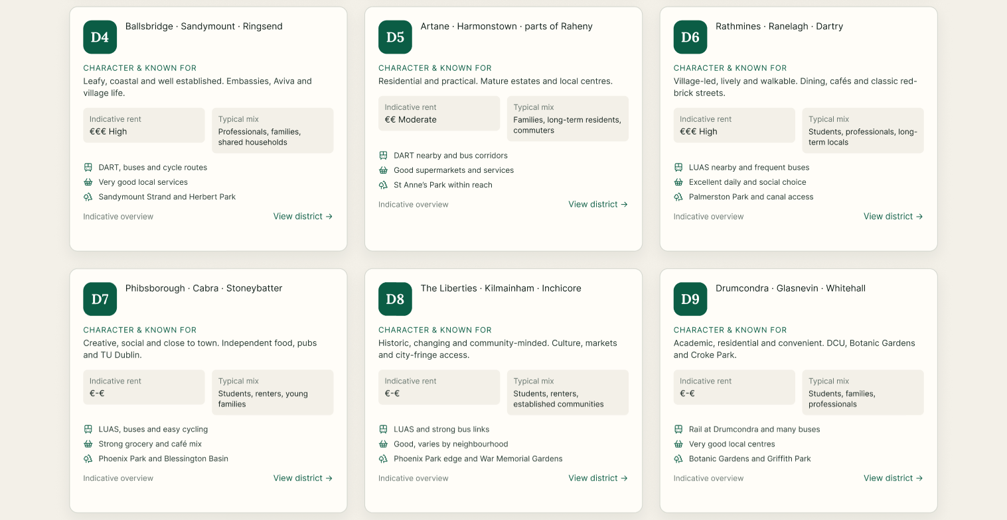
District information
The district pages show practical information without overwhelming the user

Slide 27
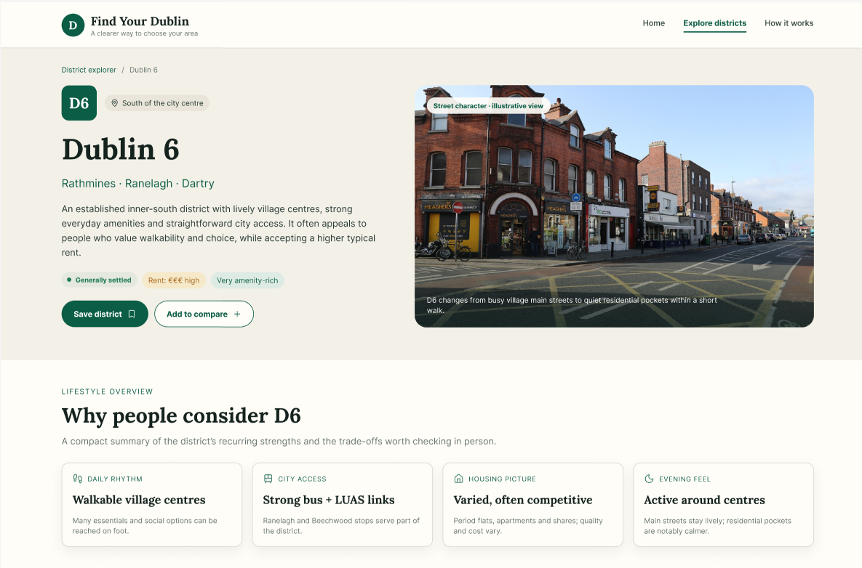
Opening a district

Slide 28
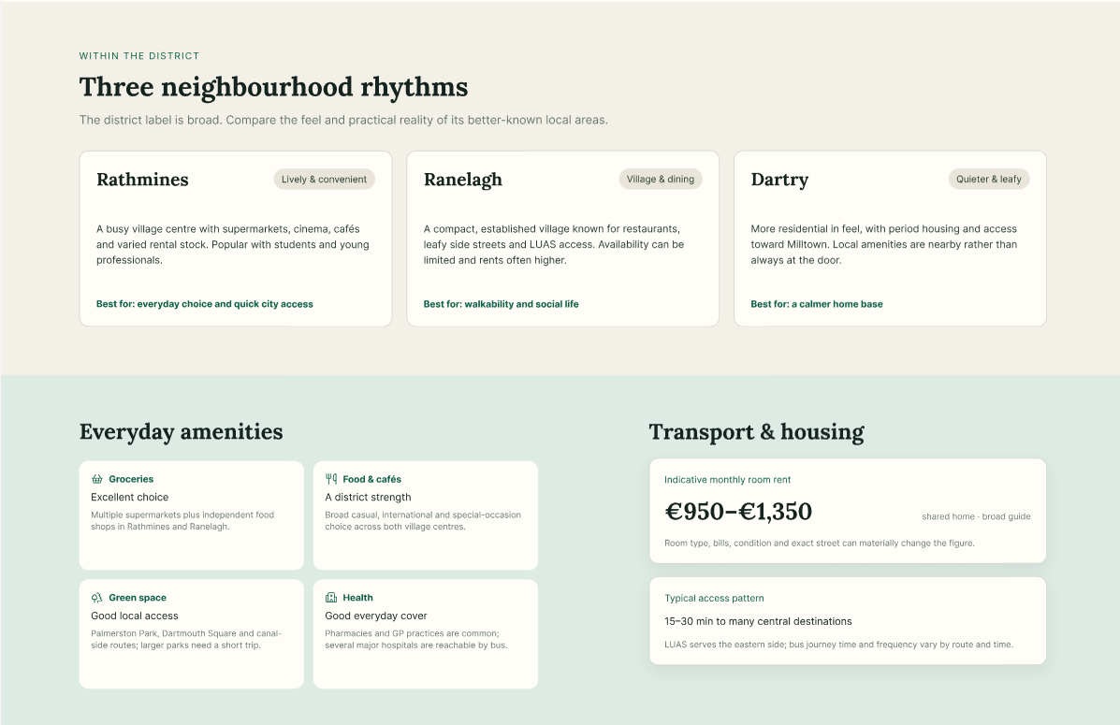
District in detail

Slide 29
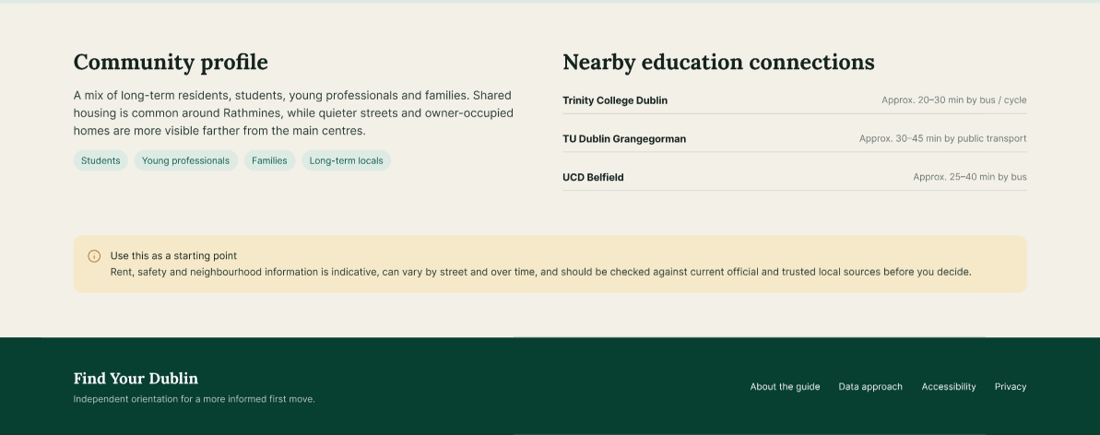

Slide 30
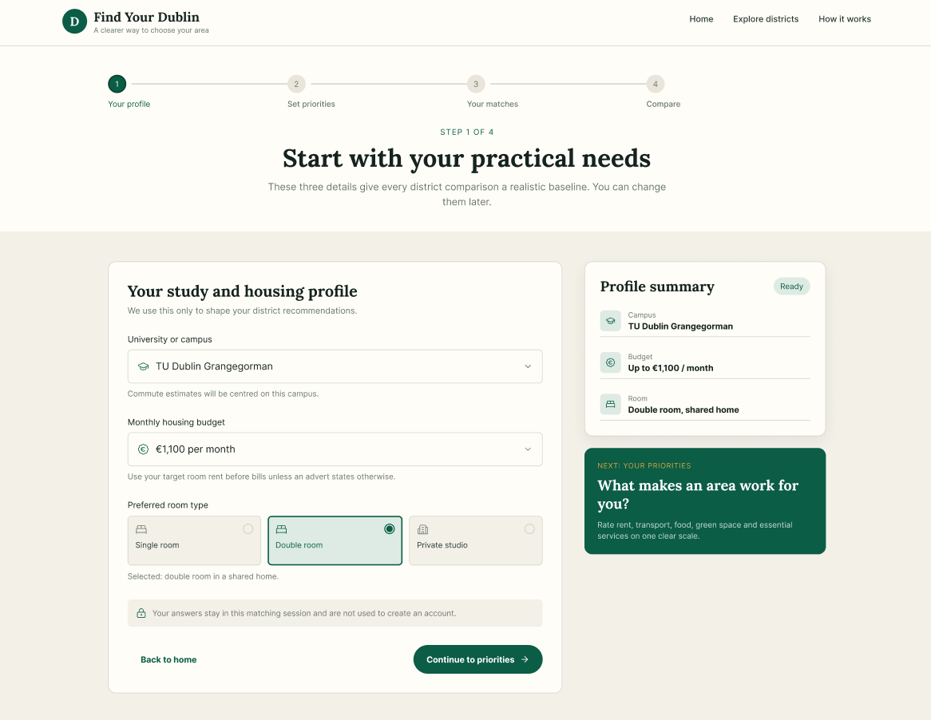
Start building user profile

Slide 31
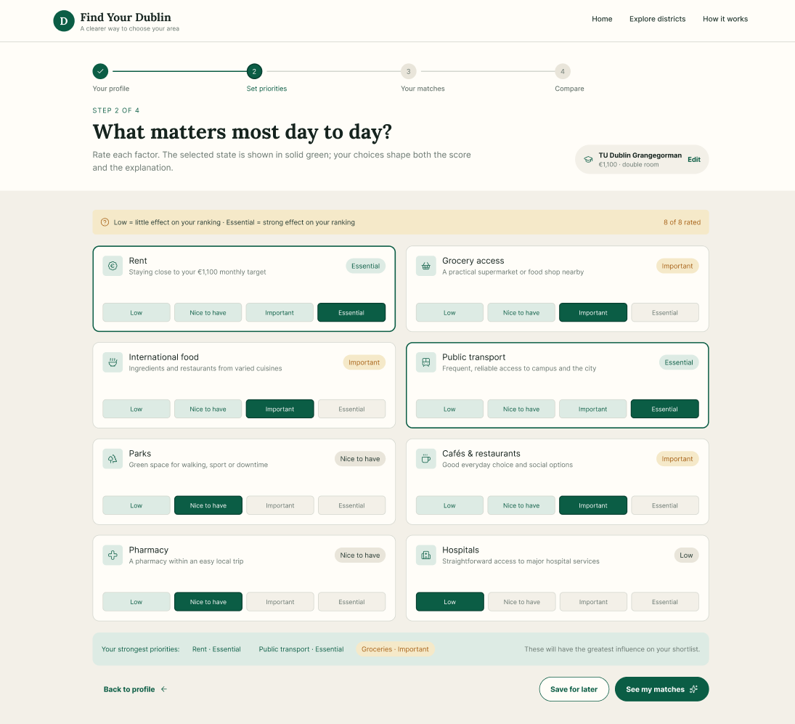
Set user priorities

Slide 32
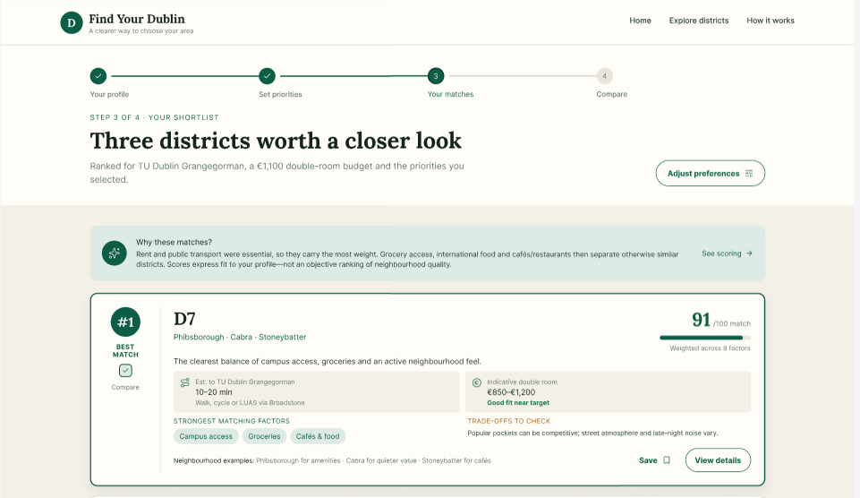
Shortlist 3 districts

Slide 33
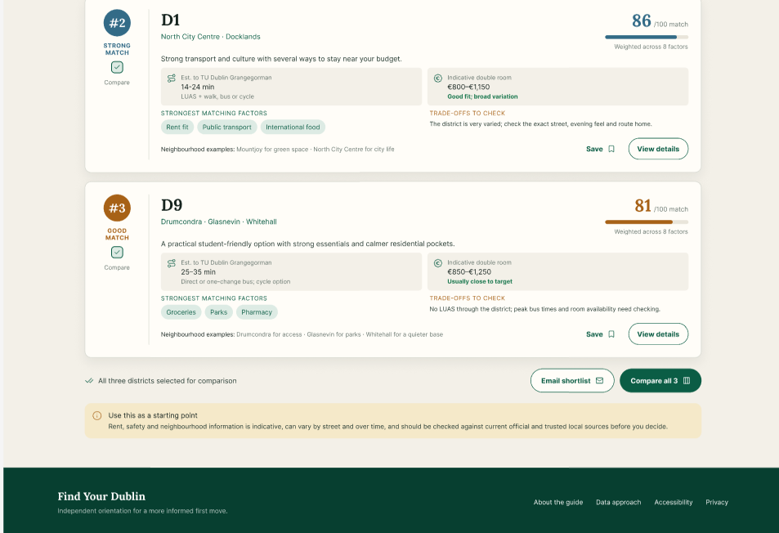

Slide 34
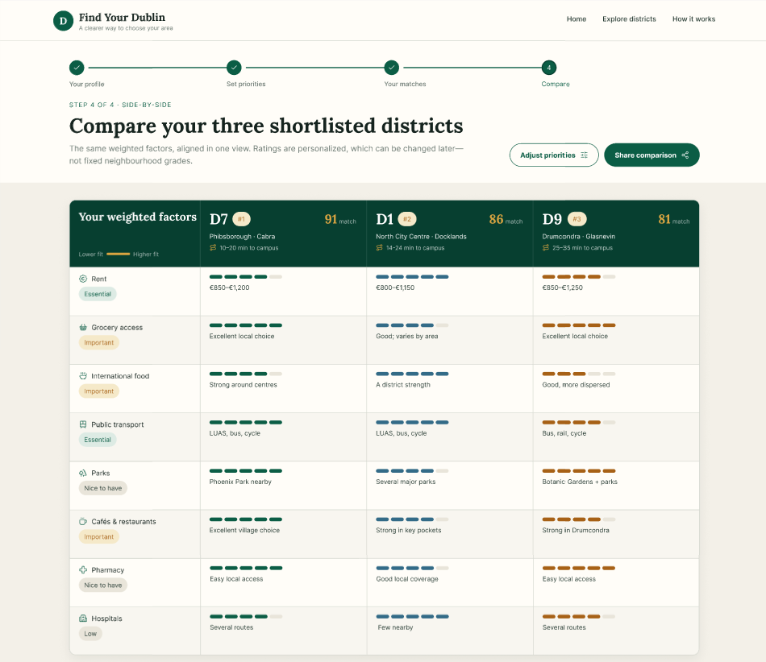
Final shortlist comparison

Slide 35
Next Steps:
• Use reliable data for rent, transport, amenities and district information.
• Define how each factor is measured and updated.
• Test the prototype with users.
• Check whether the recommendations are understandable and useful.
• Connect the Figma flow to the actual application.
• Add map view, mobile responsiveness and accessibility improvements.
The prototype is the visual foundation; data + matching + evaluation are the next technical steps.

Slide 36
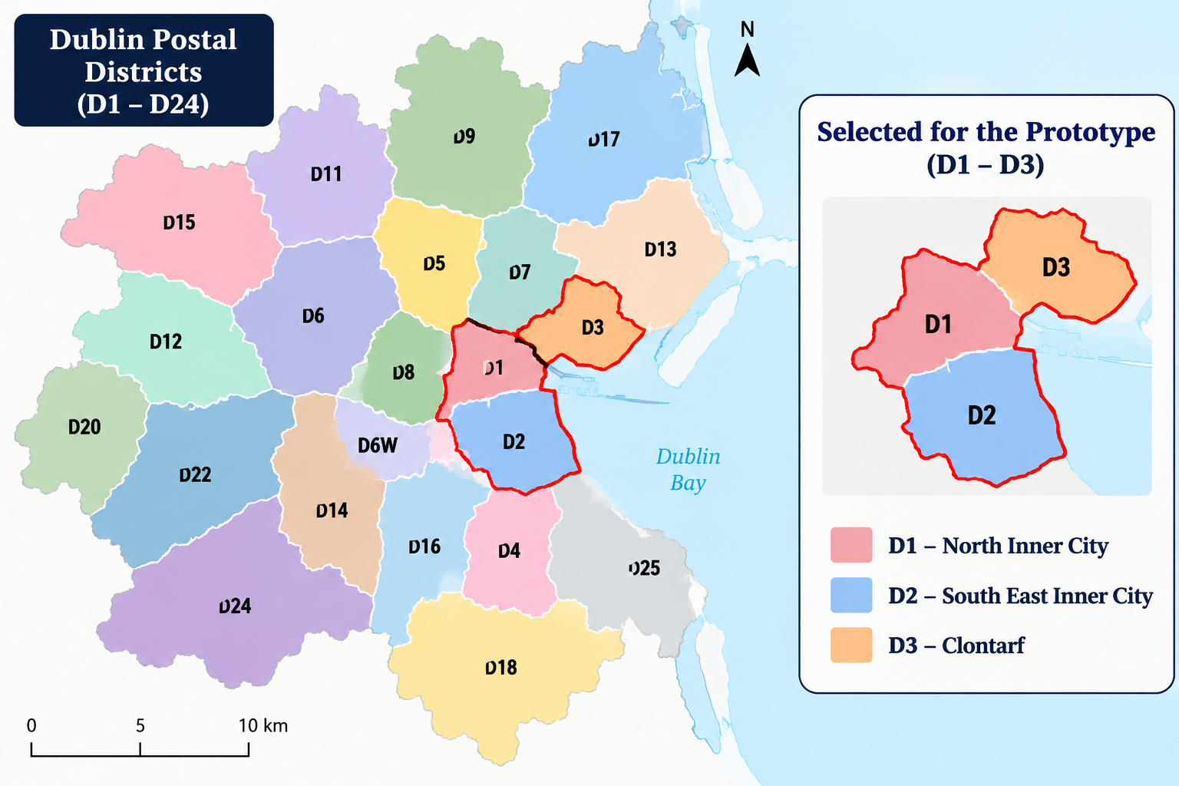
Implementation Prototype – By: Catherine Sherina
Built an initial prototype using 3 Dublin districts (D1-D3)
Used the data to test recommendation, scoring and ranking logic
The aim is to prove that the method works end to end before collecting data for every district.

Slide 37
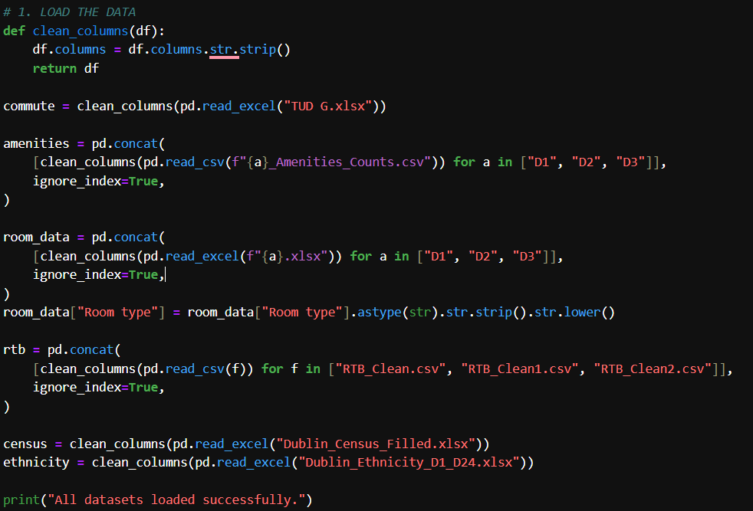
1. Data Loading and Preparation:
Pandas reads the Excel and CSV datasets into DataFrames.
pd.concat() combines the separate D1, D2 and D3 amenity and room-rent datasets.
The three RTB rental files are combined into one rental dataset.
Commute values such as '1 hr 5 mins' are converted into minutes.
Commute, amenities, Census and ethnicity data are merged using Area.

Slide 38
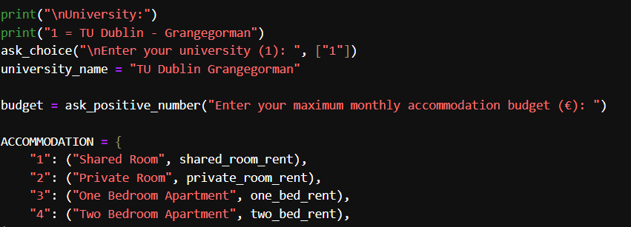

2. Student Inputs and Accommodation
The prototype then takes student inputs. The student provides their university, monthly accommodation budget, preferred accommodation type, and the importance of different factors. These preferences are converted into weights, which are later used in the recommendation scoring.

Slide 39
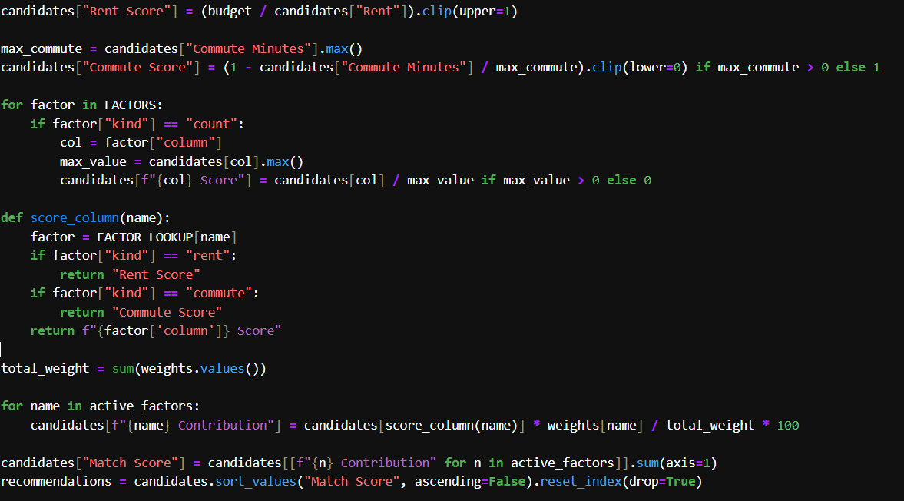
3. Scoring and Ranking Logic
Each factor is converted to a 0–1 score, where a higher score means a better match.
Rent: compares the student's budget with the area's average rent.
Commute: shorter travel time receives a higher score.
Amenities: counts are normalized against the highest value among candidate areas.
Weighted contributions are added to produce the final Match Score.
Areas are sorted from highest to lowest Match Score.

Slide 40
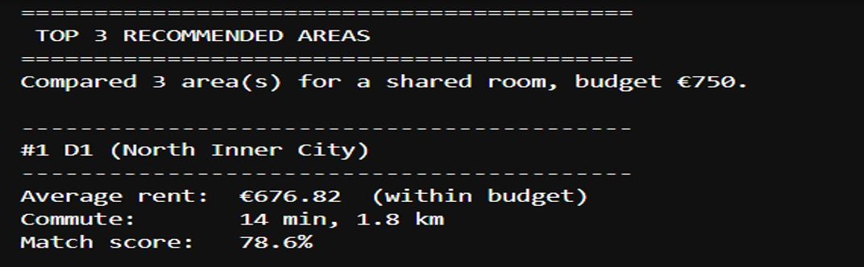
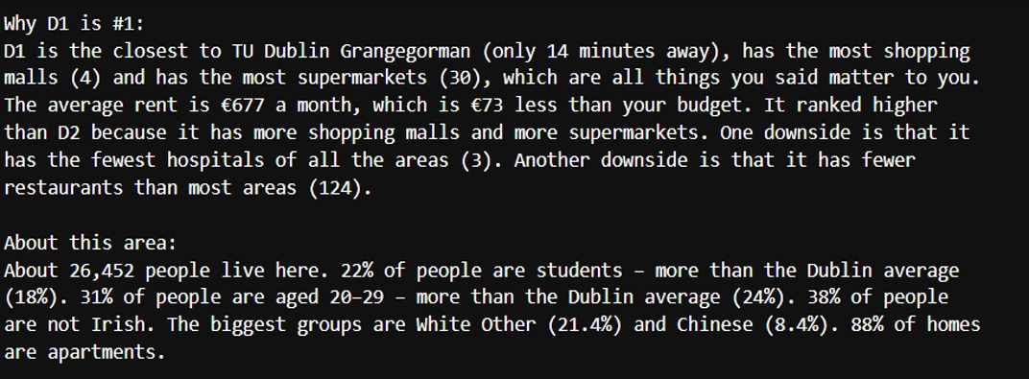
4. Output and Explainability
The prototype displays the Top 3 recommended areas.
For each area: average rent, budget status, commute, distance and Match Score are shown.
The explanation is generated from the student's actual preferences.
It identifies strengths on important factors, explains budget differences and compares nearby ranked areas.
An area profile can also describe population, student/age information, non-Irish population and housing/ethnicity information where available.

Slide 41
Prototype Today :
Room rents and amenities and other data’s for D1, D2 and D3
One university: TU Dublin Grangegorman
Next phase:
Collect data for D1–D24
Add more universities and campuses
Build a web interface and test it with students

Slide 42
Thank you!
Questions?

